Slide 1
Chapter 8: Complex Data Types

Slide 2
Outline
Object-based Databases
Semi-Structured Data
Textual Data
Spatial Data

Slide 3
Object-based Databases

Slide 4
Object-based Databases
Advanced Database Applications need Complex Data Types
Applications are often written in object-oriented programming languages（OOPL）
  Type system does not match relational type system
  Switching between imperative language and SQL is troublesome
Approaches for integrating object-orientation with databases
  Build an object-oriented database（OODB） that natively supports object-oriented data and direct access from programming language
  Build an object-relational database（ORDB）， adding object-oriented features to a relational database
  Automatically convert data between programming language model and relational model; data conversion specified by object-relational mapping(ORM)

Slide 5
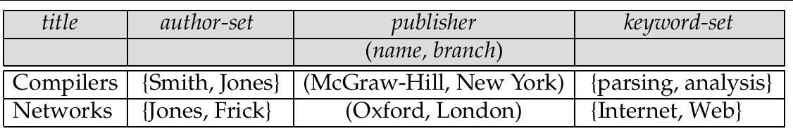
Example of a Nested Relation
Example: library information system
Each book has
  title,
  a set of authors,
  Publisher, and
  a set of keywords
Non-1NF relation books

Slide 6
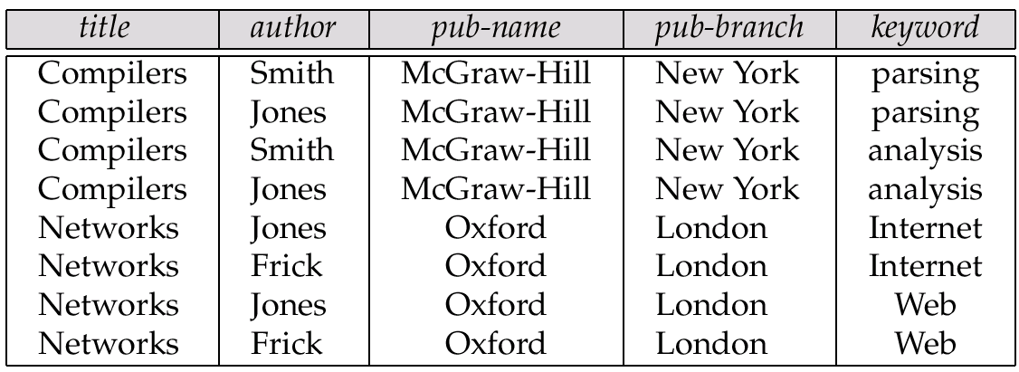
1NF Version of Nested Relation
1NF version of books
flat-books

Slide 7
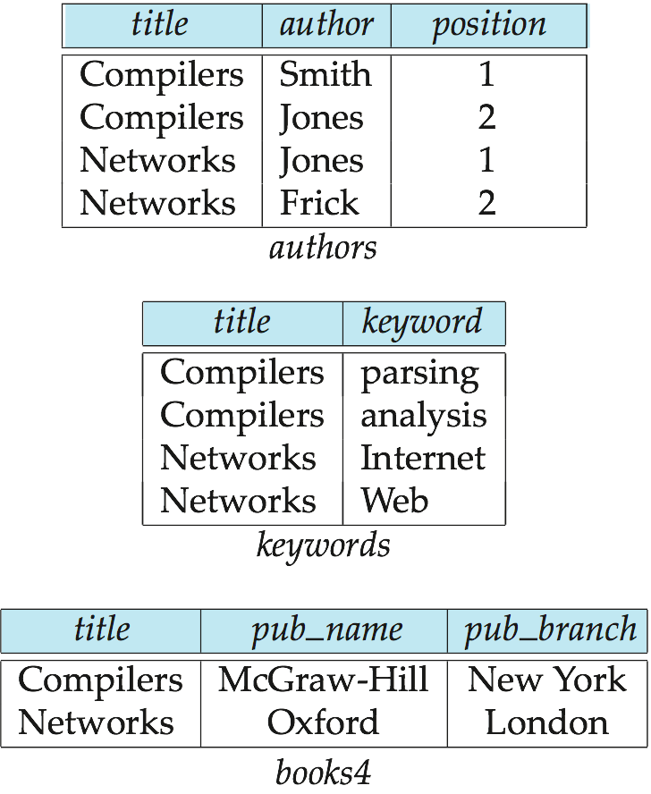
4NF Decomposition of Nested Relation
Remove awkwardness of flat-books by assuming that the following multivalued dependencies hold:
  title author
  title keyword
  title pub-name, pub-branch
Decompose flat-doc into 4NF using the schemas:
  (title, author )
  (title, keyword )
  (title, pub-name, pub-branch )

Slide 8
Complex Types and SQL:1999
Extensions to SQL to support complex types include:
  Collection types
    Nested relations are an example of collection types
  Structured types
    Nested record structures like composite attributes
  Inheritance
  Object orientation
    Including object identifiers and references
  Large object types
    BLOB, CLOB
Our description is mainly based on the SQL:1999 standard
  Not fully implemented in any database system currently
  But some features are present in each of the major commercial database systems
    Read the manual of your database system to see what it supports

Slide 9
Array and Multiset Types in SQL:1999
Example of array and multiset declaration:
create type Publisher as
(name varchar(20),
branch varchar(20))
create type Book as
(title varchar(20),
author-array varchar(20) array [10],
pub-date date,
publisher Publisher,
keyword-set varchar(20) multiset )
create table books of Book
Similar to the nested relation books, but with array of authors
instead of set

Slide 10
Object-Relational Database Systems
User-defined types
  create type Person
  (ID varchar(20) primary key,
  name varchar(20),
  address varchar(20)) ref from(ID);
  create table people of Person;
Table types
  create type interest as table (
  topic varchar(20),
  degree_of_interest int);
  create table users (
  ID varchar(20),
  name varchar(20),
  interests interest);
Array, multiset data types also supported by many databases
  Syntax varies by database

Slide 11
Type and Table Inheritance
Type inheritance
  create type Student under Person
  (degree varchar(20)) ;
  create type Teacher under Person
  (salary integer);
Table inheritance syntax in PostgreSQL and oracle
  create table students
  (degree varchar(20))
  inherits people;
  create table teachers
  (salary integer)
  inherits people;
  create table people of Person;
  create table students of Student
  under people;
  create table teachers of Teacher
  under people;

Slide 12
Reference Types
Creating reference types
  create type Person
  (ID varchar(20) primary key,
  name varchar(20),
  address varchar(20))
  ref from(ID);
  create table people of Person;
  create type Department (
  dept_name varchar(20),
  head ref(Person) scope people);
  create table departments of Department
  insert into departments values ('CS', '12345’)
  System generated references can be retrieved using subqueries
    (select ref(p) from people as p where ID = '12345')
Using references in path expressions
  select head->name, head->address
  from departments;

Slide 13
Object-Relational Mapping
Object-relational mapping (ORM) systems allow
  Specification of mapping between programming language objects and database tuples
  Automatic creation of database tuples upon creation of objects
  Automatic update/delete of database tuples when objects are update/deleted
  Interface to retrieve objects satisfying specified conditions
    Tuples in database are queried, and object created from the tuples
Details in Section 9.6.2
  Hibernate ORM for Java
  Django ORM for Python

Slide 14
Object-Relational Mapping
Hibernate ORM for Java : an example
  @Entity public class Student {
      @Id String ID;
      String name;
      String department;
      int tot cred;
  }
  Session session = getSessionFactory().openSession();
  Transaction txn = session.beginTransaction();
  Student stud = new Student("12328", "John Smith", "Comp. Sci.", 0);
  session.save(stud);
  txn.commit();
  session.close();

Slide 15
Object-Relational Mapping
As an example of the use of Hibernate, we create a Java class corresponding to the student relation as follows:
    @Entity public class Student {
        @Id String ID;
        String name;
        String department;
        int tot_cred;
    }
the annotation @Entity denotes that the class is mapped to a database relation, whose name by default is the class name, and whose attributes are by default the same as the class attributes.
The default relation name and attribute names can be overridden using @Table and @Column annotations.
The @Id annotation in the example specifies that ID is the primary key attribute.

Slide 16
Object-Relational Mapping
The following code snippet then creates a Student object and saves it to the database.
    Session session = getSessionFactory().openSession();
    Transaction txn = session.beginTransaction();
    Student stud = new Student("12328", "John Smith", "Comp. Sci.", 0);
    session.save(stud);
    txn.commit();
    session.close();

Slide 17
Object-Relational Mapping
Objects can be retrieved either by primary key or by a query, as illustrated in thefollowing code snippet:
      Session session = getSessionFactory().openSession();
      Transaction txn = session.beginTransaction();
      // Retrieve student object by identifier
      Student stud1 = session.get(Student.class, "12328");
      .. print out the Student information ..
      List students =
      session.createQuery("from Student as s order by s.ID asc").list();
      for ( Iterator iter = students.iterator(); iter.hasNext(); ) {
      Student stud = (Student) iter.next();
      .. print out the Student information ..
      }
      txn.commit();
      session.close();

Slide 18
Semi-Structured Data

Slide 19
Semi-Structured Data
Many applications require storage of complex data, whose schema changes often
The relational model’s requirement of atomic data types may be an overkill
  E.g., storing set of interests as a set-valued attribute of a user profile may be simpler than normalizing it
Data exchange can benefit greatly from semi-structured data
  Exchange can be between applications, or between back-end and front-end of an application
  Web-services are widely used today, with complex data fetched to the front-end and displayed using a mobile app or JavaScript
XML and JSON are widely used semi-structured data models
  XML: Extensible Markup Language
    Earlier generation notation, still used extensively
  JSON: JavaScript Object Notation
    Widely used today

Slide 20
Features of Semi-Structured Data Models
Flexible schema
  Wide column representation: allow each tuple to have a different set of attributes, can add new attributes at any time
  Sparse column representation: schema has a fixed but large set of attributes, by each tuple may store only a subset
Multivalued data types
  Sets, multisets
    E.g.,: set of interests {‘basketball, ‘La Liga’, ‘cooking’, ‘anime’, ‘jazz’}
  Key-value map (or just map for short)
    Store a set of key-value pairs
    E.g., {(brand, Apple), (ID, MacBook Air), (size, 13), (color, silver)}
    Operations on maps: put(key, value), get(key), delete(key)
  , Arrays
    Widely used for scientific and monitoring applications

Slide 21
Features of Semi-Structured Data Models
Arrays
  Widely used for scientific and monitoring applications
  E.g., readings taken at regular intervals can be represented as array of values instead of (time, value) pairs
    [5, 8, 9, 11] instead of {(1,5), (2, 8), (3, 9), (4, 11)}
Multi-valued attribute types
  Modeled using non first-normal-form (NFNF) data model
  Supported by most database systems today
Array database: a database that provides specialized support for arrays
  E.g., compressed storage, query language extensions etc
  Oracle GeoRaster, PostGIS, SciDB, etc

Slide 22
Nested Data Types
Hierarchical data is common in many applications
XML: Extensible Markup Language
  Earlier generation notation, still used extensively
JSON: JavaScript Object Notation
  Widely used today

Slide 23
XML
XML uses tags to mark up text
E.g.
<course>
<course id> CS-101 </course id>
<title> Intro. to Computer Science </title>
<dept name> Comp. Sci. </dept name>
<credits> 4 </credits>
</course>
Tags make the data self-documenting
Tags can be hierarchical

Slide 24
Example of Data in XML
<purchase order>
<identifier> P-101 </identifier>
<purchaser>
<name> Cray Z. Coyote </name>
<address> Route 66, Mesa Flats, Arizona 86047, USA </address>
</purchaser>
<supplier>
<name> Acme Supplies </name>
<address> 1 Broadway, New York, NY, USA </address>
</supplier>
<itemlist>
<item>
<identifier> RS1 </identifier>
<description> Atom powered rocket sled </description>
<quantity> 2 </quantity>
<price> 199.95 </price>
</item>
<item>…</item>
</itemlist>
<total cost> 429.85 </total cost>
….
</purchase order>

Slide 25
XML Cont.
XQuery language developed to query nested XML structures
  Not widely used currently
SQL extensions to support XML
  Store XML data
  Generate XML data from relational data
  Extract data from XML data types
    Path expressions
See Chapter 30 (online) for more information

Slide 26
XML example: book.xml
- <bookstore>
- <book category="COOKING“ ISBN=“100-10-00”>
<title lang="en">Everyday Italian</title>
<author>Giada De Laurentiis</author>
<year>2005</year>
<price>30.00</price>
</book>
- <book category="CHILDREN“ ISBN=“10000-100-199”>
<title lang="en">Harry Potter</title>
<author>J K. Rowling</author>
<year>2005</year>
<price>29.99</price>
<publisher> ABC</publisher>
<edition>5 </edition>
</book>
- <book category="WEB“ ISBN=“10000-10-09”>
<title lang="en">XQuery Kick Start</title>
<author>James McGovern</author>
<author>Per Bothner</author>
<year>2003</year>
<price>49.99</price>
</book>
- <book category="WEB“ ISBN=“999-11-09”>
<title lang="en">Learning XML</title>
<author>Erik T. Ray</author>
<year>2003</year>
<price>39.95</price>
</book>
</bookstore>

Slide 27
Tree model of XML documents
bookstore
book
book
…
book
title
author
year
price
…
title
author
author
year
price
Harry Potter
J K. Rowling
2005
29.99
XQuery Kick Start
James McGovern
2003
49.99
Per Bothner
bookstore/book
bookstore/book[1]/title
bookstore/book[price>30]/title

Slide 28
DTD of bookstore
<!DOCTYPE bookstore [
  <!ELEMENT bookstore ( (book)+)>
  <!ELEMENT book ( title,author+,year,price,publisher*,edition*)>
  <!ELEMENT title (#PCDATA)>
  <!ELEMENT author (#PCDATA)>
  <!ELEMENT year (#PCDATA)>
  <!ELEMENT price (#PCDATA)>
  <!ATTLIST book category CDATA #REQUIRED
  ISBN ID #REQUIRED>
  <!ATTLIST title lang CDATA #REQUIRED >
  ]>

Slide 29
XPath expressions
bookstore
book
book
…
book
title
author
year
price
…
title
author
author
year
price
Harry Potter
J K. Rowling
2005
29.99
XQuery Kick Start
James McGovern
2003
49.99
Per Bothner
bookstore/book[1]/title
bookstore/book/author
bookstore/book[price>30]/year
bookstore/book[1]/title/text()

Slide 30
XQuery
<book_pairs>
for $a in /bookstore/book
$b in /bookstore/book
where $a/author[1]=$b/author[1] and $a/price>$b/price
return <book_pair>
{<first_author> data($a/author[1]) </first_author>
$a/title $b/title}
</book_pair>
</book_pairs>

Slide 31
JSON
Textual representation widely used for data exchange
Example of JSON data
{
"ID": "22222",
"name": {
"firstname: "Albert",
"lastname: "Einstein"
},
"deptname": "Physics",
"children": [
{"firstname": "Hans", "lastname": "Einstein" },
{"firstname": "Eduard", "lastname": "Einstein" }
]
}
Types: integer, real, string, and
  Objects: are key-value maps, i.e. sets of (attribute name, value) pairs
  Arrays are also key-value maps (from offset to value)

Slide 32
JSON
JSON is ubiquitous in data exchange today
  Widely used for web services
  Most modern applications are architected around on web services
SQL extensions for
  JSON types for storing JSON data
  Extracting data from JSON objects using path expressions
    E.g. V-> ID, or v.ID
  Generating JSON from relational data
    E.g. json.build_object(‘ID’, 12345, ‘name’, ‘Einstein’)
  Creation of JSON collections using aggregation
    E.g. json_agg aggregate function in PostgreSQL
  Syntax varies greatly across databases
JSON is verbose
  Compressed representations such as BSON (Binary JSON) used for efficient data storage

Slide 33
RDF
(Resource Description Format)

Slide 34
Knowledge Representation
Representation of human knowledge is a long-standing goal of AI
  Various representations of facts and inference rules proposed over time
RDF: Resource Description Format
  Simplified representation for facts, represented as triples
  (subject, predicate, object)
    E.g., (NBA-2019, winner, Raptors)
    (Washington-DC, capital-of, USA)
    (Washington-DC, population, 6,200,000)
  Models objects that have attributes, and relationships with other objects
    Like the ER model, but with a flexible schema
    (ID, attribute-name, value)
    (ID1, relationship-name, ID2)
  Has a natural graph representation

Slide 35
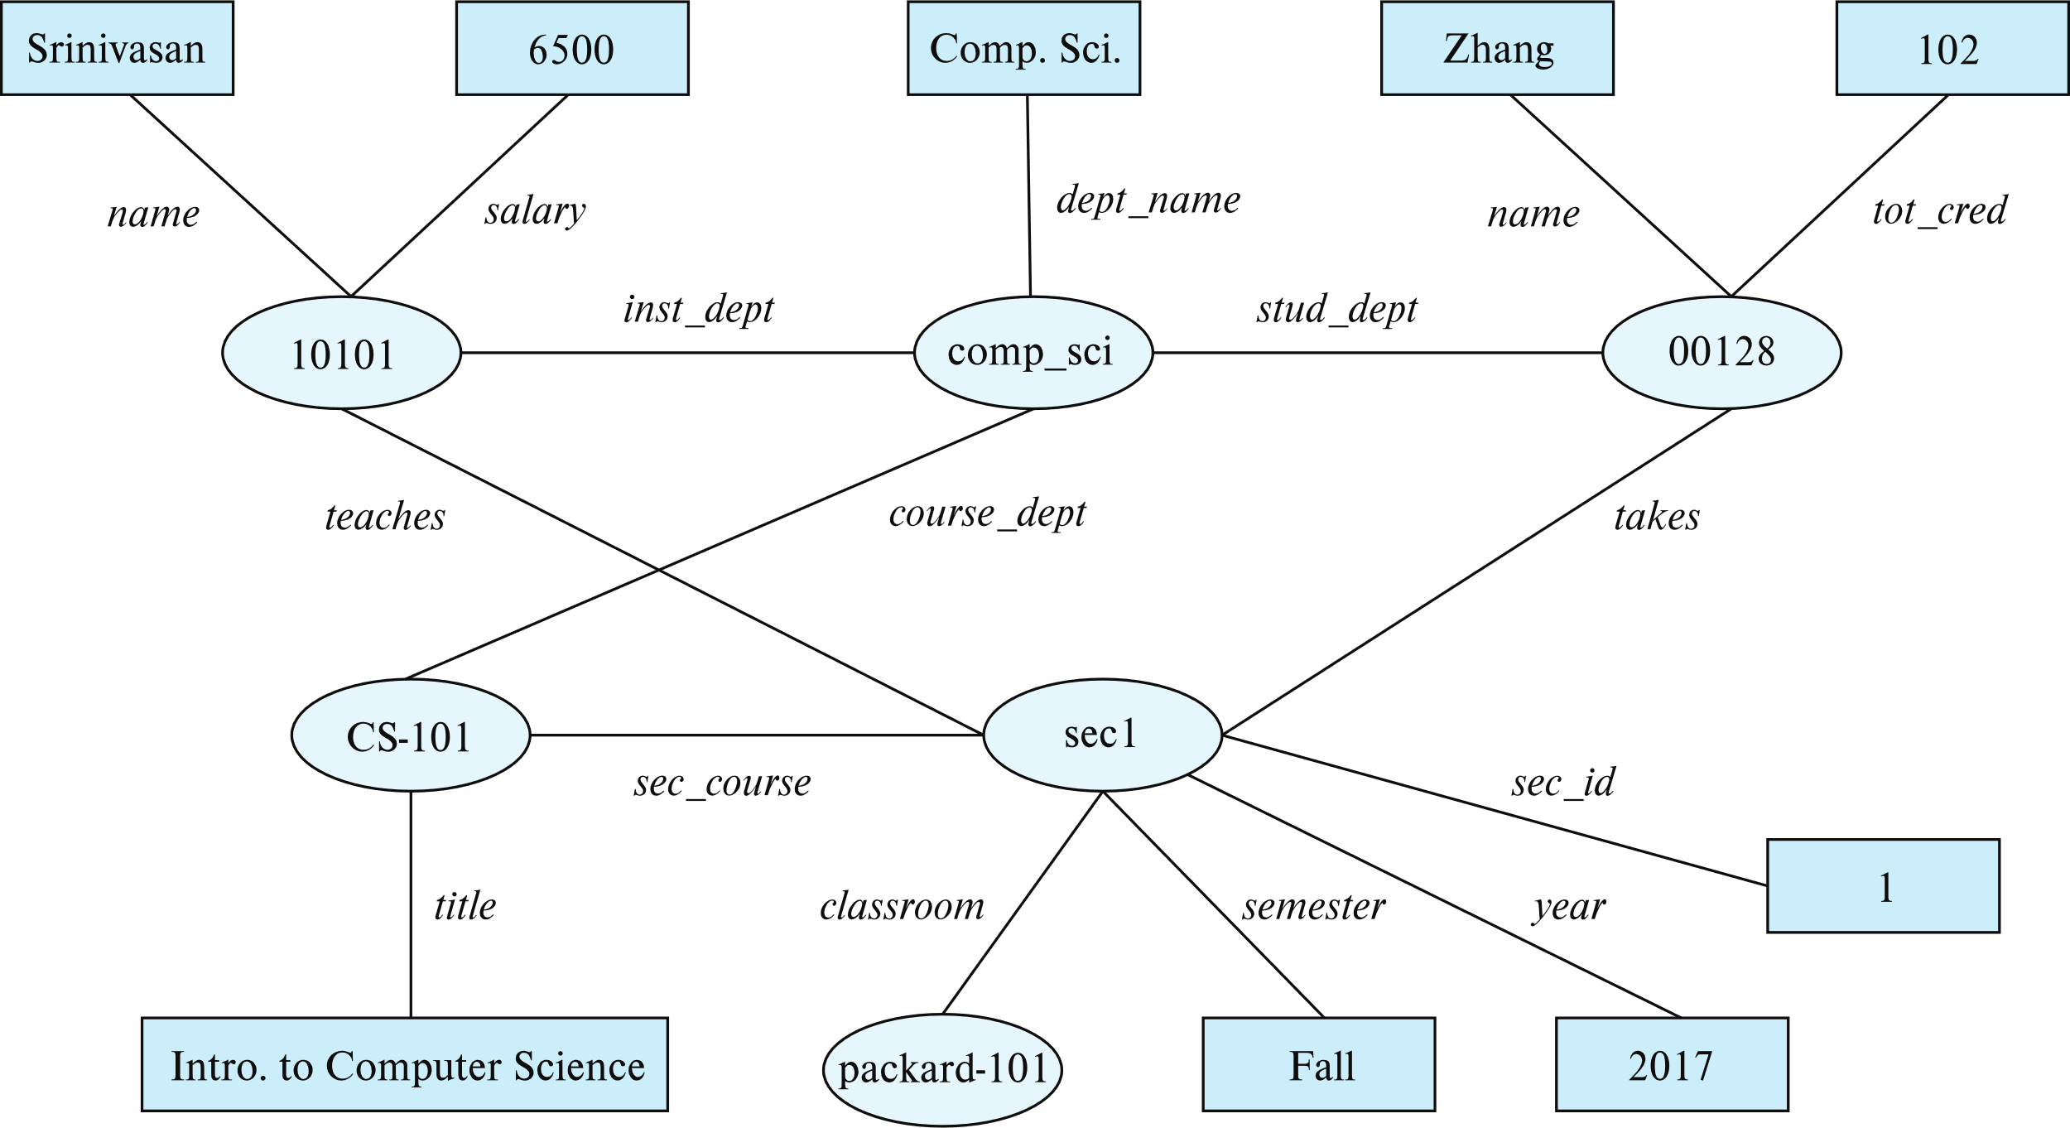
Graph View of RDF Data
Knowledge graph

Slide 36
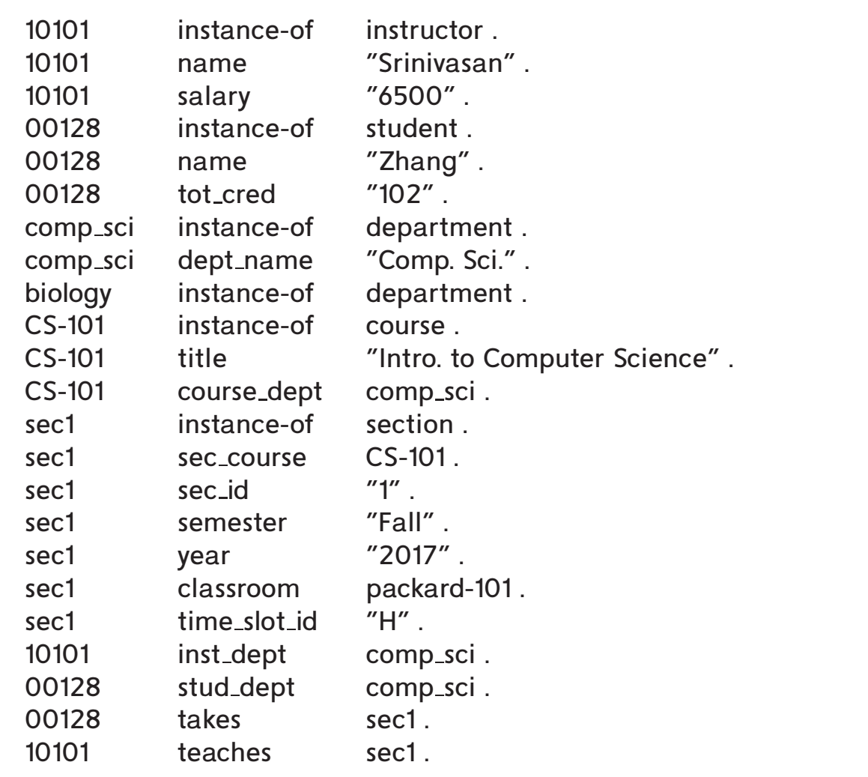
Triple View of RDF Data

Slide 37
Querying RDF: SPARQL
Triple patterns
  ?cid title "Intro. to Computer Science"
  ?cid title "Intro. to Computer Science"
  ?sid course ?cid
SPARQL queries
  select ?name
  where {
  ?cid title "Intro. to Computer Science" .
  ?sid course ?cid .
  ?id takes ?sid .
  ?id name ?name .
  }
  Also supports
    Aggregation, Optional joins (similar to outerjoins), Subqueries, etc.
    Transitive closure on paths

Slide 38
RDF Representation (Cont.)
RDF triples represent binary relationships
How to represent n-ary relationships?
  Approach 1 (from Section 6.9.4): Create artificial entity, and link to each of the n entities
    E.g., (Barack Obama, president-of, USA, 2008-2016) can be represented as
    (e1, person, Barack Obama), (e1, country, USA),
    (e1, president-from, 2008) (e1, president-till, 2016)
  Approach 2: use quads instead of triples, with context entity
    E.g., (Barack Obama, president-of, USA, c1)
    (c1, president-from, 2008) (c1, president-till, 2016)
RDF widely used as knowledge base representation
  DBPedia, Yago, Freebase, WikiData, ..
Linked open data project aims to connect different knowledge graphs to allow queries to span databases

Slide 39
Textual Data

Slide 40
Textual Data
Information retrieval: querying of unstructured data
  Simple model of keyword queries: given query keywords, retrieve documents containing all the keywords
  More advanced models rank relevance of documents
  Today, keyword queries return many types of information as answers
    E.g., a query “cricket” typically returns information about ongoing cricket matches
Relevance ranking
  Essential since there are usually many documents matching keywords

Slide 41
Ranking using TF-IDF
Term: keyword occurring in a document/query
Term Frequency: TF(d, t), the relevance of a term t to a document d
  One definition: TF(d, t) = log(1 + n(d,t)/n(d))
  where
    n(d,t) = number of occurrences of term t in document d
    n(d) = number of terms in document d
Inverse document frequency: IDF(t)
  One definition: IDF(t) = 1/n(t)
Relevance of a document d to a set of terms Q
  One definition: r(d, Q) = ∑_{t∈Q} TF(d, t) ∗ IDF(t)
  Other definitions
    take proximity of words into account
    Stop words are often ignored

Slide 42
Ranking Using Hyperlinks
Hyperlinks provide very important clues to importance
Google introduced PageRank, a measure of popularity/importance based on hyperlinks to pages
  Pages hyperlinked from many pages should have higher PageRank
  Pages hyperlinked from pages with higher PageRank should have higher PageRank
  Formalized by random walk model
Let T[i, j] be the probability that a random walker who is on page i will click on the link to page j
  Assuming all links are equal, T[i, j] = 1∕Ni
Then PageRank[j] for each page j can be defined as
  P[j] = δ∕N + (1 - δ) ∗ ∑_{i=1}^{N} (T[i, j] ∗ P[i])
  Where N = total number of pages, and δ a constant usually set to 0.15

Slide 43
Ranking Using Hyperlinks
Definition of PageRank is circular, but can be solved as a set of linear equations
  Simple iterative technique works well
  Initialize all P[i] = 1/N
  In each iteration use equation P[j] = δ∕N + (1 - δ) ∗ ∑_{i=1}^{N} (T[i, j] ∗ P[i]) to update P
  Stop iteration when changes are small, or some limit (say 30 iterations) is reached.
Other measures of relevance are also important. For example:
  Keywords in anchor text
  Number of times who ask a query click on a link if it is returned as an answer

Slide 44
Retrieval Effectiveness
Measures of effectiveness
  Precision: what percentage of returned results are actually relevant
  Recall: what percentage of relevant results were returned
  At some number of answers, e.g. precision@10, recall@10
Keyword querying on structured data and knowledge bases
  Useful if users don’t know schema, or there is no predefined schema
  Can represent data as graphs
  Keywords match tuples
  Keyword search returns closely connected tuples that contain keywords
    E.g. on our university database given query “Zhang Katz”, Zhang matches a student, Katz an instructor and advisor relationship links them

Slide 45
Spatial Data

Slide 46
Spatial Data
Spatial databases store information related to spatial locations, and support efficient storage, indexing and querying of spatial data.
  Geographic data -- road maps, land-usage maps, topographic elevation maps, political maps showing boundaries, land-ownership maps, and so on.
    Geographic information systems are special-purpose databases tailored for storing geographic data.
    Round-earth coordinate system may be used
      (Latitude, longitude, elevation)
  Geometric data: design information about how objects are constructed . For example, designs of buildings, aircraft, layouts of integrated-circuits.
    2 or 3 dimensional Euclidean space with (X, Y, Z) coordinates

Slide 47
Represented of Geometric Information
Various geometric constructs can be represented in a database in a normalized fashion (see next slide)
A line segment can be represented by the coordinates of its endpoints.
A polyline or linestring consists of a connected sequence of line segments and can be represented by a list containing the coordinates of the endpoints of the segments, in sequence.
  Approximate a curve by partitioning it into a sequence of segments
    Useful for two-dimensional features such as roads.
    Some systems also support circular arcs as primitives, allowing curves to be represented as sequences of arc
Polygons is represented by a list of vertices in order.
  The list of vertices specifies the boundary of a polygonal region.
  Can also be represented as a set of triangles (triangulation)

Slide 48
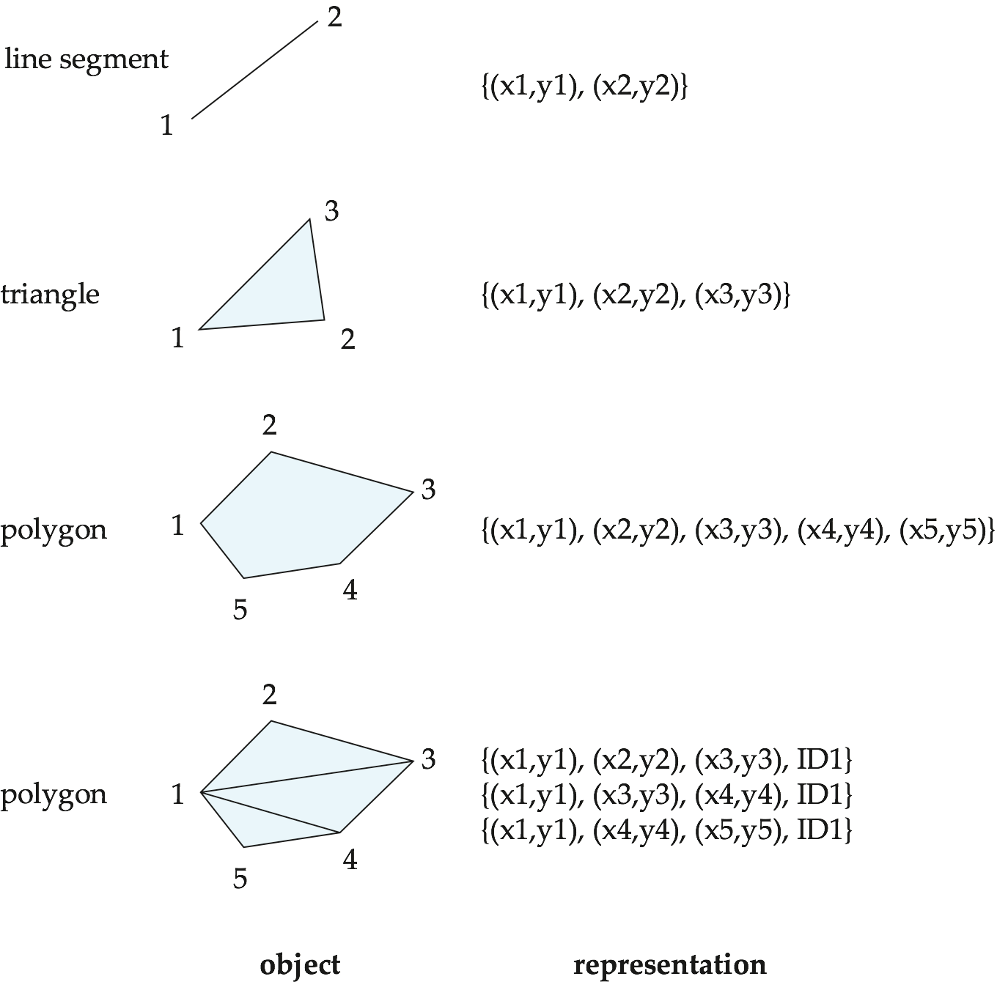
Representation of Geometric Constructs

Slide 49
Representation of Geometric Information (Cont.)
Representation of points and line segment in 3-D similar to 2-D, except that points have an extra z component
Represent arbitrary polyhedra by dividing them into tetrahedrons, like triangulating polygons.
Alternative: List their faces, each of which is a polygon, along with an indication of which side of the face is inside the polyhedron.
Geometry and geography data types supported by many databases
  E.g. SQL Server and PostGIS
  point, linestring, curve, polygons
  Collections: multipoint, multilinestring, multicurve, multipolygon
  LINESTRING(1 1, 2 3, 4 4)
  POLYGON((1 1, 2 3, 4 4, 1 1))
  Type conversions: ST GeometryFromText() and ST GeographyFromText()
  Operations: ST Union(), ST Intersection(), …

Slide 50
Design Databases
Represent design components as objects (generally geometric objects); the connections between the objects indicate how the design is structured.
Simple two-dimensional objects: points, lines, triangles, rectangles, polygons.
Complex two-dimensional objects: formed from simple objects via union, intersection, and difference operations.
Complex three-dimensional objects: formed from simpler objects such as spheres, cylinders, and cuboids, by union, intersection, and difference operations.
Wireframe models represent three-dimensional surfaces as a set of simpler objects.

Slide 51
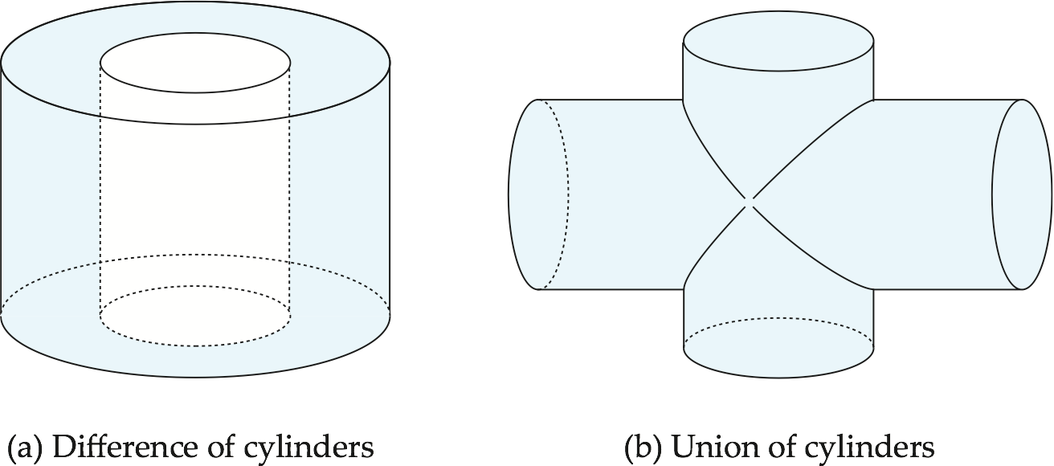
Representation of Geometric Constructs
Design databases also store non-spatial information about objects (e.g., construction material, color, etc.)
Spatial integrity constraints are important.
  E.g., pipes should not intersect, wires should not be too close to each other, etc.

Slide 52
Geographic Data
Raster data consist of bit maps or pixel maps, in two or more dimensions.
  Example 2-D raster image: satellite image of cloud cover, where each pixel stores the cloud visibility in a particular area.
  Additional dimensions might include the temperature at different altitudes at different regions, or measurements taken at different points in time.
Design databases generally do not store raster data.

Slide 53
Geographic Data (Cont.)
Vector data are constructed from basic geometric objects: points, line segments, triangles, and other polygons in two dimensions, and cylinders, spheres, cuboids, and other polyhedrons in three dimensions.
Vector format often used to represent map data.
  Roads can be considered as two-dimensional and represented by lines and curves.
  Some features, such as rivers, may be represented either as complex curves or as complex polygons, depending on whether their width is relevant.
  Features such as regions and lakes can be depicted as polygons.

Slide 54
Spatial Queries
Region queries deal with spatial regions. e.g., ask for objects that lie partially or fully inside a specified region
  E.g., PostGIS ST_Contains(), ST_Overlaps(), …
Nearness queries request objects that lie near a specified location.
Nearest neighbor queries, given a point or an object, find the nearest object that satisfies given conditions.
Spatial graph queries request information based on spatial graphs
  E.g., shortest path between two points via a road network
Spatial join of two spatial relations with the location playing the role of join attribute.
Queries that compute intersections or unions of regions

Slide 55
End of Chapter 8

